Slide 1
Using ATUS 2020 Data to Investigate COVID-19 Influences on Daily Behaviors and Interactions PAA 2022 - April 6, 2022
Liana C. Sayer
Maryland Time Use Lab
Maryland Population Research Center
University of Maryland
lsayer@umd.edu
Sarah M. Flood
IPUMS, Life Course Center
Minnesota Population Center
University of Minnesota
floo0017@umn.edu
Notes:
Please put any and all questions as they come up in the chat.

Slide 2
Notes:
The COVID-19 pandemic arguably affected every single person in the world. During this public health crisis, schools closed, workplaces shifted to remote work when possible, and many low wage workers suddenly became essential workers who had to be at work despite the coronavirus running rampant through communities. Social distancing kept people at home and away from their families and friends. For some, trips to the grocery store were replaced by grocery delivery. Others tried to reduce the number of trips they made to stores. Daily routines were disrupted. Suddenly the taken for grantedness of daily life was exposed and upended. Everyone suddenly had to navigate changing rules about who could leave the house, for what, and whether it was safe to be around people who you didn’t live with. This massive disruption to social life didn’t end as stay-at-home orders were lifted.

Slide 3
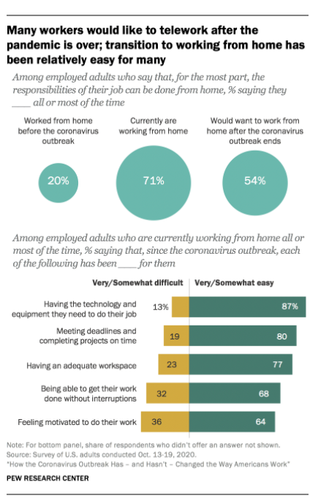
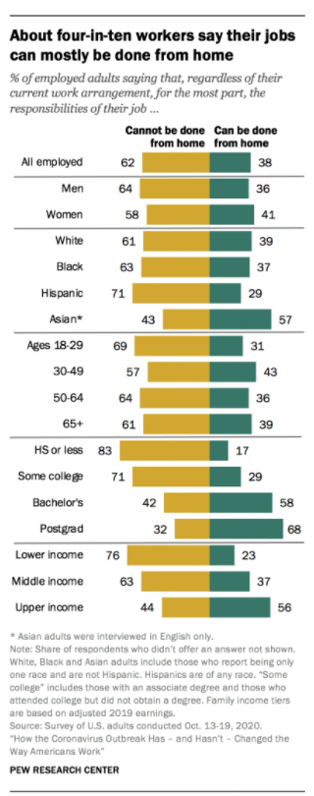
Notes:
The COVID-19 pandemic arguably affected every single person in the world. During this public health crisis, schools closed, workplaces shifted to remote work when possible, and many low wage workers suddenly became essential workers who had to be at work despite the coronavirus running rampant through communities. Social distancing kept people at home and away from their families and friends. For some, trips to the grocery store were replaced by grocery delivery. Others tried to reduce the number of trips they made to stores. Daily routines were disrupted. Suddenly the taken for grantedness of daily life was exposed and upended. Everyone suddenly had to navigate changing rules about who could leave the house, for what, and whether it was safe to be around people who you didn’t live with. This massive disruption to social life didn’t end as stay-at-home orders were lifted.

Slide 4
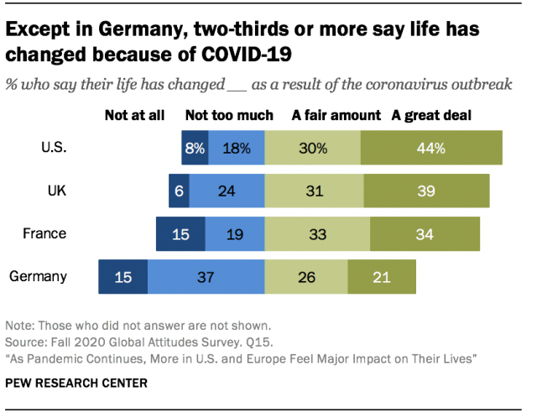
Notes:
In Fall 2020, a Pew Research report indicates that 74% of Americans say their life has changed a fair amount or a great deal as a result of the coronovarius outbreak.
The American Time Use Survey is arguably the ideal dataset to examine changes in daily behaviors, where they occur, and patterns of social interaction given the temporal scope of the data. The ATUS includes annual data from 2003 to 2019 from population representative samples and data from during the COVID-19 pandemic (May to December 2020). We argue that changes in daily routines and behaviors are best understood in recent temporal context.

Slide 5
Benefits of the ATUS
Data on what, when, where, and with whom Americans spend time
Temporal scope: 2003-2020
2021 available this summer
Rich information about respondents and household members
Large, nationally representative samples
Population subgroups
State and substate geography (see working paper)
Notes:
Several data collections sprang up during the pandemic to begin to understand the quick spread of the deadly coronavirus and the impacts of this massive public health crisis on daily life. These studies are important. They often contain rich data on perceptions and attitudes and provide a lens for understanding the health and well being of people throughout the world.
But as I mentioned before, daily routines were disrupted and it wasn’t until this happened that the ways we spend our time changed so radically that there was widespread interest in the use of time.
So here we are – together today to learn more about the ATUS, which is truly a national treasure for investigating how the COVID-19 pandemic influenced daily behaviors and interactions.
I want to quickly highlight some of the benefits of the ATUS.

Slide 6
Opportunities!
Examine what, when, where, and with whom Americans do things in 2020 compared to previous years
Parental time use – did differences between mothers and fathers increase or decrease?
Gendered housework – did the increase in remote work shift responsibilities in the home?
Physical activity – does time freed up from commuting translate into more physical activity?
What do you want to do with the data?
Combine other data with the ATUS:
Time varying stay-at home order data
COVID infection rates
Occupational characteristics

Slide 7
ATUS + Well-Being Data
2010, 2012, 2013 Well-Being Module of the ATUS
Experienced happiness, meaning, sadness, stress, pain, and fatigue for three randomly selected activities
2021 data are coming!
Supported by grants from NICHD and NSF. Look for the data late summer 2022
Data identical with earlier WB data
Collected during the COVID-19 pandemic

Slide 8
Objectives
Become familiar with IPUMS Time Use data extract system
Develop knowledge about issues associated with analyzing the 2020 ATUS data
Practice navigating and accessing data from IPUMS Time Use
Gain experience analyzing 2020 ATUS data

Slide 9
Part 1: Learn about the IPUMS Time Use Archives

Slide 10
What is IPUMS?
Previously an acronym for Integrated Public Use Microdata Series – now just “IPUMS”
US and international census and survey data
NIH and NSF funding to improve data accessibility
Integrated documentation and standardized data to streamline analysis
Available free of charge
Notes:
We get asked often what IPUMS stands for. It was previously an acronym for Integrated public use microdata series, but now we are just IPUMS.
We curate, document, harmonize, and deliver US and international census and survey data to the research community. Our goal is to improve and simplify access to the world’s population microdata and our focus to date has been on large-scale census and survey data.
At a high level, we standardize data across time and place so that members of the research community have a common starting point for their research and spend more time analyzing the data. Our work eliminates the need for every researcher to locate multiple datasets and navigate differences in variable names and coding schemes.
We also make documentation available where researchers need it. We provide documentation at the variable level, for example, so that researchers using census data from multiple countries can know quickly what issues they might encounter making comparisons across countries.
All of these data are freely available.
We do a lot of the behind the scenes work. Now let’s talk about what you need to do to use IPUMS.

Slide 11
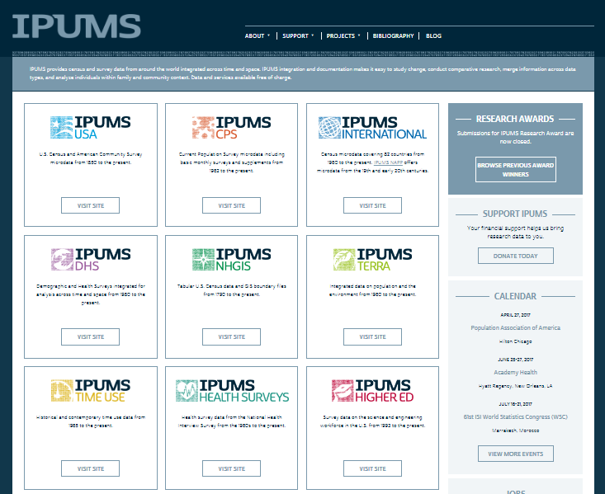
http://www.ipums.org/
Notes:
IPUMS Time Use is part of a suite of IPUMS projects at the University of Minnesota
IPUMS stands for: Integrated Public Use Microdata Series
However, it is now just “IPUMS”
Developed by the University of Minnesota and archived at the University of Minnesota
Originally contained census data for the U.S. and other nations
Now has time use data in a similar web-based system

Slide 12
The IPUMS Model
Deliver data and documentation available via web-based dissemination system
Enable researchers to
Create customized data extracts
Download and analyze microdata
Provide user support through tutorials, user forum, and dedicated user support team
Notes:
To use IPUMS you register and visit ipums.org which is where we make all of the standardized data and documentation available to researchers via web-based data dissemination systems.
From IPUMS researchers can create customized datasets so that they get only the years and countries of data they want and only the variables they need for their analysis. Our system creates the dataset exactly specified by the researcher.
The researcher then downloads and analyzes the microdata.
And we have an amazing user support team ready to help you – via email or a user forum -- if you run into problems. In addition we’ve developed tutorials and training exercises.

Slide 13
A Note on Data Sources
In general, IPUMS takes microdata that is already publicly available and makes it easier to use
Exceptions:
Many censuses in IPUMS International are not available anywhere else
Full-count US census data were digitized by IPUMS in collaboration with Ancestry.com and the Church of Latter-day Saints
Notes:
Note that thus far I haven’t talked about data collection. That’s because this isn’t something we do. We repackage publicly available microdata and make it easier to use and harmonize it across time and place.
However, we do hold some data that are not available anywhere else including several census in IPUMS International and full-count US census data that we digitized in collaboration with Ancestry.com and the Church of Latter-day saints.

Slide 14
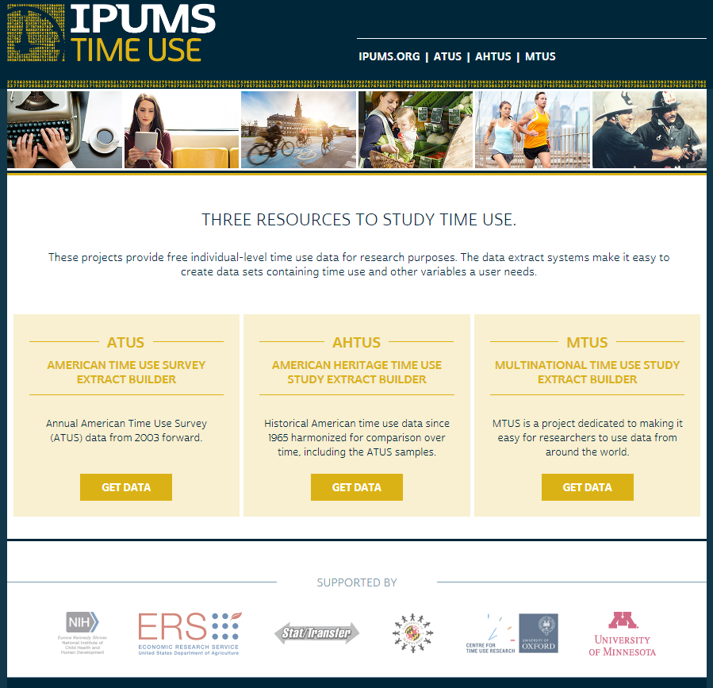
Notes:
IPUMS Time Use consists of three databases. They all provide access to time diary data, but are harmonized differently.

Slide 15
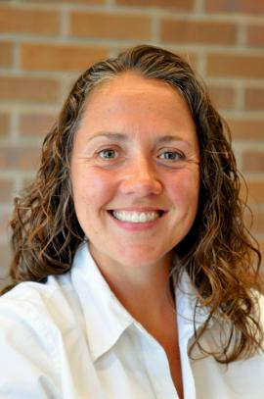
IPUMS Time Use Team
Maryland Population Research Center
University College London, Centre for Time Use Research
IPUMS & Minnesota Population Center
Sandra Hofferth
Liana Sayer
Sarah Flood
Margarita Vega Rapun
Kelsey Drotning
Jonathan Gershuny
Dan Backman

Slide 16
ATUS
2003-present survey & time diary data
Persons ages 15 and older who completed a 20-minute telephone CATI interview conducted by the U.S. Census Bureau for the Bureau of Labor Statistics
Annual data released in summer each year
Occasional supplements with focused items:
Leave, Eating and Health, Well-Being
Primary source for annual estimates of population time allocation

Slide 17
Sample Diary
Notes:
The data are complex to use because respondents report all of the activities they engage in over the course of a 24 hour period. So each person has many reported activities that you can use to build measures of time spent in the activities that you are interested in.

Slide 18
ATUS Sampling Frame
People are selected from households that recently completed the monthly labor force survey – the Current Population Survey (CPS)

Slide 19
ATUS Sample Allocation
The ATUS sample is split evenly between weekdays and weekend days
10 percent of designated persons are asked about a weekday
25 percent of designated persons in the sample are asked about a Saturday, and 25 percent are asked about a Sunday

Slide 20
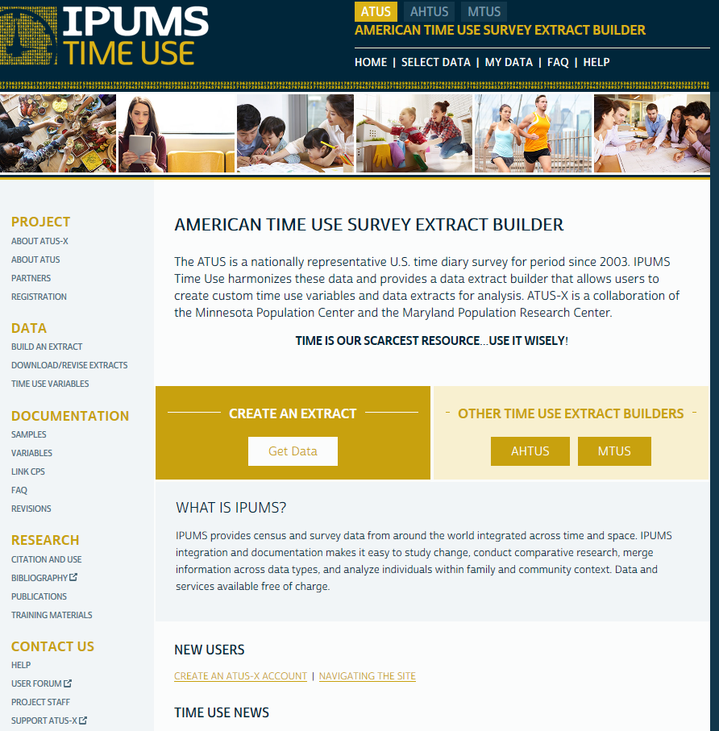

Slide 21
What IPUMS Time Use Provides
Easy access to the years of data you want
Data harmonized across time and countries
User-defined measures of time in specific activity aggregations
Dataset and variable-level documentation in one place and connected to your variables, plus variable-level frequencies
Data in multiple formats (SAS, STATA, SPSS)
Notes:
Powerful web-based interface allows creation of customized, easy-to-use data extracts & user-defined measures of time in specific activity aggregations

Slide 22
What is Harmonization?
Creating a single, consistent data series from datasets collected at different times
Applying a coding scheme to group broadly comparable categories but retain additional detail when available
Documenting these decisions and flagging potential comparability issues
Notes:
Back to what we do – harmonization. So what is harmonization?

Slide 23
Changes to Detail in ATUS Activity Codes
2003 170502 Work-related travel, not commuting
2004 170502 Travel related to work-related activities
2005 180502 Travel related to work-related activities
HARMONIZED Codes and Labels
2003-
2020 180502 Travel related to work-related activities
Same code
Different Label
Different code
Same Label
Notes:
Here is a simple example of what harmonization looks like. There was a fair amount of change in ATUS activity codes in the early years of data collection. Code 170502 appeared in both 2003 and 2004, but had different labels. Between 2004 and 2005, the codes changed but the labels remained the same. This is all well documented by the BLS. However, rather than each researcher needing to navigate these changes in codes and labels, we do it through the process of harmonization. Essentially in this example, we determine that codes 170502 and codes 180502 have the same meaning and that changing labels don’t mean a change in what’s that activity code represents. Then we use our custom software to line up the activity code categories that have the same meaning and assign them the same codes and a single label.
This is a simple example intended to illustrate what harmonization is. I could provide other examples that are more involved.

Slide 24
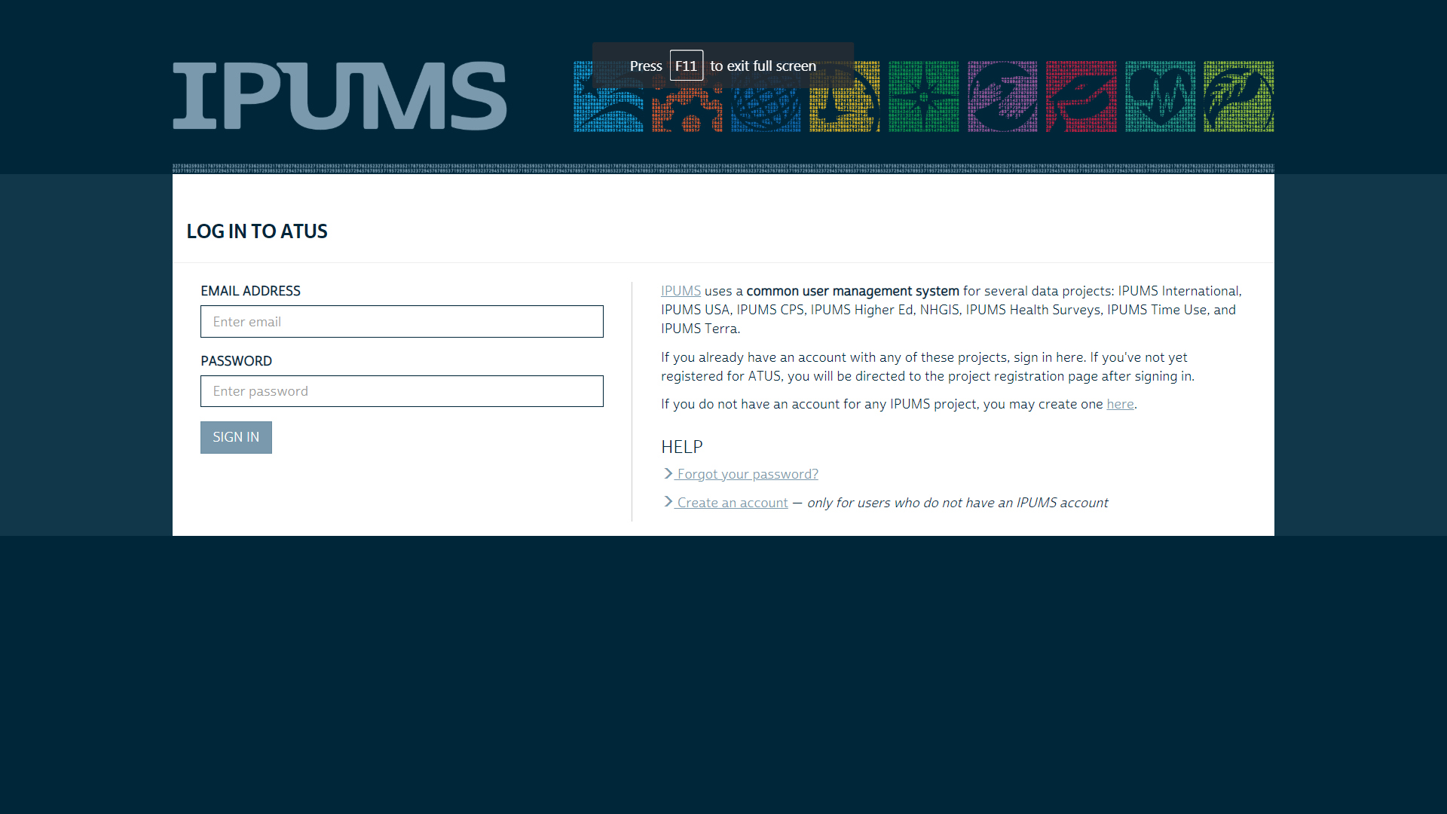
IPUMS Time Use Registration
https://www.ipums.org/timeuse.shtml
Select “Get Data” Under ATUS
Click on “Registration”
Log in with your IPUMS account information
Or
Apply for access: fill out form to register for access
Can explore data archive without an account but cannot save variables or an extract

Slide 25
Why use IPUMS Time Use?
Lowers barriers to access – much is done for the user behind the scenes to make the data easier to use
Lowers start up costs – everything in one place
Simplifies use of complex time diary data
Email helpline: ipums@umn.edu
Notes:
Powerful web-based interface allows creation of customized, easy-to-use data extracts & user-defined measures of time in specific activity aggregations

Slide 26
Part 2: Overview of 2020 ATUS Data Analysis Issues

Slide 27
Three Issues
Partial-year 2020 data
Cannot produce 2020 annual estimates of time use
Affects ability to account for seasonal variation in work, school, time outdoors and with others
Which days to include
Which days and which weight for comparisons to 2020
ATUS sample quality
Lower response rates for CPS and ATUS

Slide 28
Disruptions to Data Collection
Data collection was paused between March 18, 2020 and May 9, 2020
Resulted in a partial year data collection for 2020
January 1, 2020 to March 17, 2020
May 10, 2020 to December 31, 2020
Call and processing centers shut down
Call center interviewers worked remotely when data collection resumed
BLS documentation about impact of pandemic on 2020 ATUS: https://www.bls.gov/tus/covid19.htm
Notes:
The BLS data center was shut down in the early months of the COVID-19 pandemic
Processing centers sent materials about the survey. This was paused until mid-May.

Slide 29
2020 ATUS Data Collection
Jan
Feb
March 18 – First Day of Data Collection Pause
May 9 – Last Day of Data Collection Pause
Jun
Mar
Apr
May
Jul
Aug
Sep
Oct
Nov
Dec
No Data Collection due to Pause

Slide 30
Disruptions to Data Collection
Data collection was paused between March 18, 2020 and May 09, 2020
Resulted in a partial year data collection for 2020 – January 1, 2020 to March 17, 2020 & May 10, 2020 to December 31, 2020
Call and processing centers shut down
Call center interviewers worked remotely when data collection resumed
BLS documentation about impact of pandemic on 2020 ATUS: https://www.bls.gov/tus/covid19.htm
Notes:
The BLS data center was shut down in the early months of the COVID-19 pandemic
Processing centers sent materials about the survey. This was paused until mid-May.

Slide 31
Concerns about CPS Sample
Lower than normal response rates March – June.
Response rates were closer to normal when in-person interviews resumed in July
Documentation from BLS: https://www.bls.gov/covid19/effects-of-covid-19-pandemic-and-response-on-the-employment-situation-news-release.htm

Slide 32
BLS Approach to 2020 Data
Produce weights that reflect partial year data collection – appropriate for generating estimates of time use before or after the onset of the pandemic
Documentation in user guide about using final weights for 2003 to 2019 and the 2020 weight for 2020 data
Annual news release compares the May 10 to December 31 periods in 2019 and 2020

Slide 33
Impacts on Weights
Full-year weights available for 2003-2019
WT06 in IPUMS
No full year of data in 2020, so no full-year weight
Partial-year weights available for 2019 & 2020
WT20 in IPUMS
2020 weights are representative of days when diaries were collected in 2020, not all diary days across the year

Slide 34
Notes:
This slide just shows the same things as the previous one but in the IPUMS Time Use system context.

Slide 35
Summary to this Point
ATUS data are an amazing resource for understanding impacts of pandemic on time use and well-being!
Data collection was paused in 2020
No annual estimates
Pre-COVID and COVID data
2020 weights are different
This weight also exists for 2019
COVID changed a lot of things and it could have affected the ATUS sample; CPS sample was affected
BLS recommends
Using WT06 for 2003-2019 and WT20 for 2020
They limit their news release to 2019 and 2020 May to December and apply the 2020 weight

Slide 36
More Questions and What We’ve Learned

Slide 37
Additional Questions
Were ATUS respondents during COVID different from pre-COVID respondents?
What weight do I use if I want to include 2003-2018 data in my analysis?
Which diary days should I be using from 2003-2019? What about from 2020?
Others?
Notes:
Pause here and see what else people might be wondering before we tell them what we learned and make our recommendations.

Slide 38
Our Approach
Use 2019 and 2020 ATUS data to
Compare ATUS sample characteristics in 2020 with ATUS sample characteristics in 2019
Compare time use patterns in the 2020 data with the 2019 data
Use different sets of diary days and weights for analyses

Slide 39
Comparisons across Four Samples
Full year 2019 + partial year 2020 (January 1 to March 17 & May 10 to December 31)
Partial year 2019 + partial year 2020
May to December 2019 + May to December 2020
Full year 2019 and May to December 2020

Slide 40
Comparisons across Four Samples
 |  | 2019
 |  | January 1 to December 31 | May 10 to December 31 | January 1 to March 17 + May 10 to December 31
2020 | May 10 to December 31 | 4 | 3 | --
 | January 1 to March 17 + May 10 to December 31 | 1 | -- | 2
Notes:
1. Full year 2019 + partial year 2020 (January 1 to March 17 & May 10 to December 31)
2. Partial year 2019 + partial year 2020
The big question is which of these since most people probably want to focus on effects of pandemic on time use:
3. May to December 2019 + May to December 2020 – BLS published stats
4. Full year 2019 and May to December 2020

Slide 41
Findings about Sample Differences
Sample characteristics in 2019 and 2020 are remarkably similar
Significant differences are in characteristics likely impacted by the COVID pandemic
Employment
Income
Suggests time use variation between the pre- pandemic period and the pandemic period should not be due primarily to sample differences in 2020 and 2019

Slide 42
Weighted Within Year Comparisons
Race/Ethnicity
Employment
Number of Adults, Children
Family Income
Marital Status
Gender
Education
Diary Day
Age
Notes:
The proportion of employed respondents in January to March was .65 and .59 in May to December. This is not a surprise given the impact of the pandemic on employment. When using WT20, were no other differences in the May to December vs. Jan-Mar subsamples in 2020. That increases our confidence that the covid-period ATUS subsample is not systematically different from the pre-covid period sample.
Unweighted estimates also showed that the covid-period sample was slightly less likely to be Hispanic and less likely to have a family income under $25,000.

Slide 43
Weighted Across Year Comparisons
Comparing May to December 2019 with 2020, 2020 respondents:
Less likely to be employed
Less likely to have family income <$25,000
More likely to have family income >=$75,000
Comparing May to December 2020 with full year 2019, 2020 respondents
More likely to live in larger households

Slide 44
Magnitude of Across Year Differences
 | Jan to Dec 2019 | May to Dec 2019 | May to Dec 2020
Employed | 0.63 | 0.63 | 0.59
Two adults | -- | 0.55 | 0.52
Three or more adults | -- | 0.26 | 0.29
Less than $25,000 | 0.16 | 0.16 | 0.13
$75,000-$149,999 | 0.28 | 0.28 | 0.30
$150,000 or more | 0.14 | 0.15 | 0.17
*Proportions shown are significantly different from 2020 May to Dec

Slide 45
Time Use Findings
Differences between 2019 and 2020 time use are greater than would be expected without the pandemic
More housework, time on the phone, and leisure during the pandemic
Less time in consumer purchases, religious activities, traveling, and volunteering

Slide 46
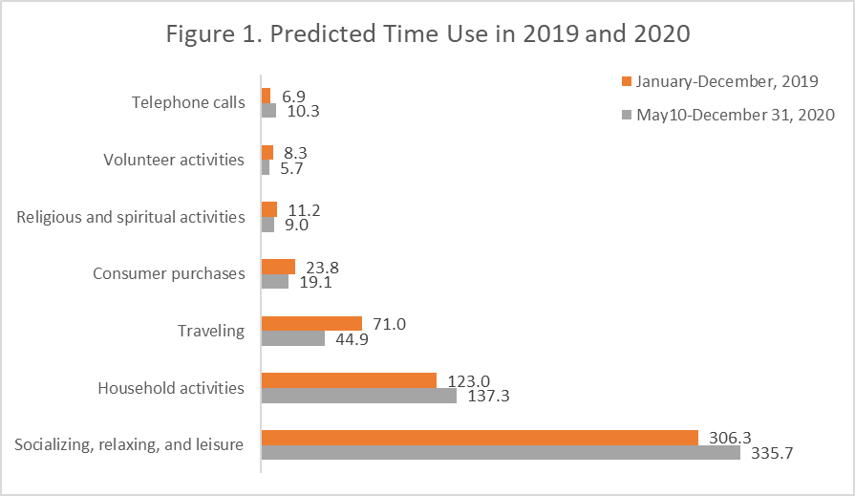

Slide 47
Notes:
These are adjusted differences between 2019 and 2020 using different combinations of subsamples and weights.
The green outline shows the coefficients that we presented graphically in the previous slide.
The blue outlined columns are our first big take away message:
The coefficients in the last two columns are extremely similar. You get very similar differences between 2019 and 2020 in the aggregate if you use either the full year of 2019 data and WT06 or the May to December 2019 data with WT20.
The red outlined columns compared to the blue show that when you use all of the 2020 data – so including the January to March data, differences between 2019 and 2020 are still in the same direction as when you focus on the May to December 2020 data only but the coefficients are slightly attenuated in most cases.
Essentially you get a slightly larger differences between 2019 and 2020 if you eliminate the January to March data, but the results are qualitatively similar. They’re also robust to weighting choices.

Slide 48
Guidance on Samples and Weights
Use full year samples for 2003-2019 and the May to December 2020 subsample when comparing pre-pandemic and pandemic periods
Use WT06 for 2003-2019 and WT20 for 2020 data
Working paper: https://doi.org/10.18128/IPUMS2021-04
Robustness checks won’t hurt either!

Slide 49
Part 3: Guided Tour of IPUMS Time Use
www.atusdata.org

Slide 50
Things to cover
Registration
Citation
Selecting samples and variables
Variable documentation
Building time use variables
Data formats
Downloading datasets

Slide 51
Part 4: Practice Exercises

Slide 52
New Data in 2021 ATUS
Well-Being Module
Affect data for 3 activities (happy, sad, tired, stress, pain, meaning)
General health
Covid question
Life Satisfaction
Fully comparable with 2010, 2012, 2013 Well-Being Modules

Slide 53
Office Hours and Evaluation
Link to Evaluation on Qualtrics
Office Hours: April 20 1:30-3:00 CT via zoom
Register

Slide 54
Acknowledgements
This project was made possible through funding from the Eunice Kennedy Shriver National Institute of Child Health and Human Development, Grant No. R01-HD053654

Slide 55
Want More? https://www.atusdata.org/atus/training_materials.shtml
Thanks for your participation!
Questions can be sent to floo0017@umn.edu, lsayer@umd.edu or ipums@umn.edu

